Slide 1

BDAT 1000 – Data Manipulation Techniques
Assignment 5
Team :-
Joyson Gonsalves – 200533709
Chirag Talaviya - 200569395

Slide 2

Agenda
Original Purpose of the Data
Key Variables and Research Questions
Data Manipulation Steps
Problems During Data Preparation
Dashboard

Slide 3

Title: Understanding Employment Dynamics in Canada
The Canadian Employment Insurance Coverage Survey studies access to EI benefits for the jobless and those in underemployment. It also explores gender, education, and regional employment dynamics. The survey conducted annually by Statistics Canada identifies groups with low benefit reception and offers insights into job search intensity.
Study the relationship between:
Gender and employment.
Education level and employment.
Employment dynamics across regions.

Slide 4

Problem Faced
SAS Studio Shutdown Issue:
Large Dataset Caused Shutdown
Stack Overflow Solution: Limited Output with ODS to 4000 Rows
Excel File Download:
Missing Data Issue Encountered
Standardization Applied for Data Cleanliness
Unknown Variables:
Some Variables Not Familiar
Additional Research Conducted for Clarity

Slide 5

Data Manipulation Steps
Data Set Size Issue:
Faced challenges in SAS Studio due to the substantial dataset.
Implemented a solution found on StackOverflow, limiting output using ODS to 4000 rows.
Data Download and Standardization:
Downloaded the dataset, identified missing data issues in the Excel file.
Conducted standardization to ensure a cleaner and consistent dataset.
Variable Identification:
Encountered unknown variables in the dataset.
Conducted additional research to identify and understand these variables.
Additional Data Challenges:
Experienced discrepancies in downloaded Excel data.
Undertook measures to address and rectify missing or inconsistent information.

Slide 6

Key Variables
Educational Attainment: Investigated the educational levels of the participants, categorizing them into distinct groups.
Employment Status: Examined the employment situations of individuals, distinguishing between full-time, part-time, and unemployed.
Household income: "Household Income" represents the total earnings of a household, serving as a crucial metric to assess economic well-being and disparities among different population segments based on income levels.
Gender: Gender categorizes individuals as male or female, enabling the exploration of disparities and patterns in socio-economic factors within the dataset.
These key variables were selected to provide comprehensive insights into the relationships and patterns within the dataset, forming the foundation for our research questions and subsequent analysis.

Slide 7

Research Questions
Research Question 1: How does the highest educational attainment of individuals correlate with their current employment status, and is there an association suggesting that individuals with higher educational qualifications are more likely to be employed full-time?
Research Question 2: In what manner does the breakdown of individuals, categorized by full-time employment, part-time employment, and unemployment, differ when comparing males and females?
Research Question 3: How does household income vary among individuals with different levels of educational attainment? Is there a significant income disparity between individuals with post-graduate education and those with lower educational qualifications?
Research Question 4 : What is the employment status distribution (unemployed, full-time, part-time, or "not stated") across different regions?

Slide 8
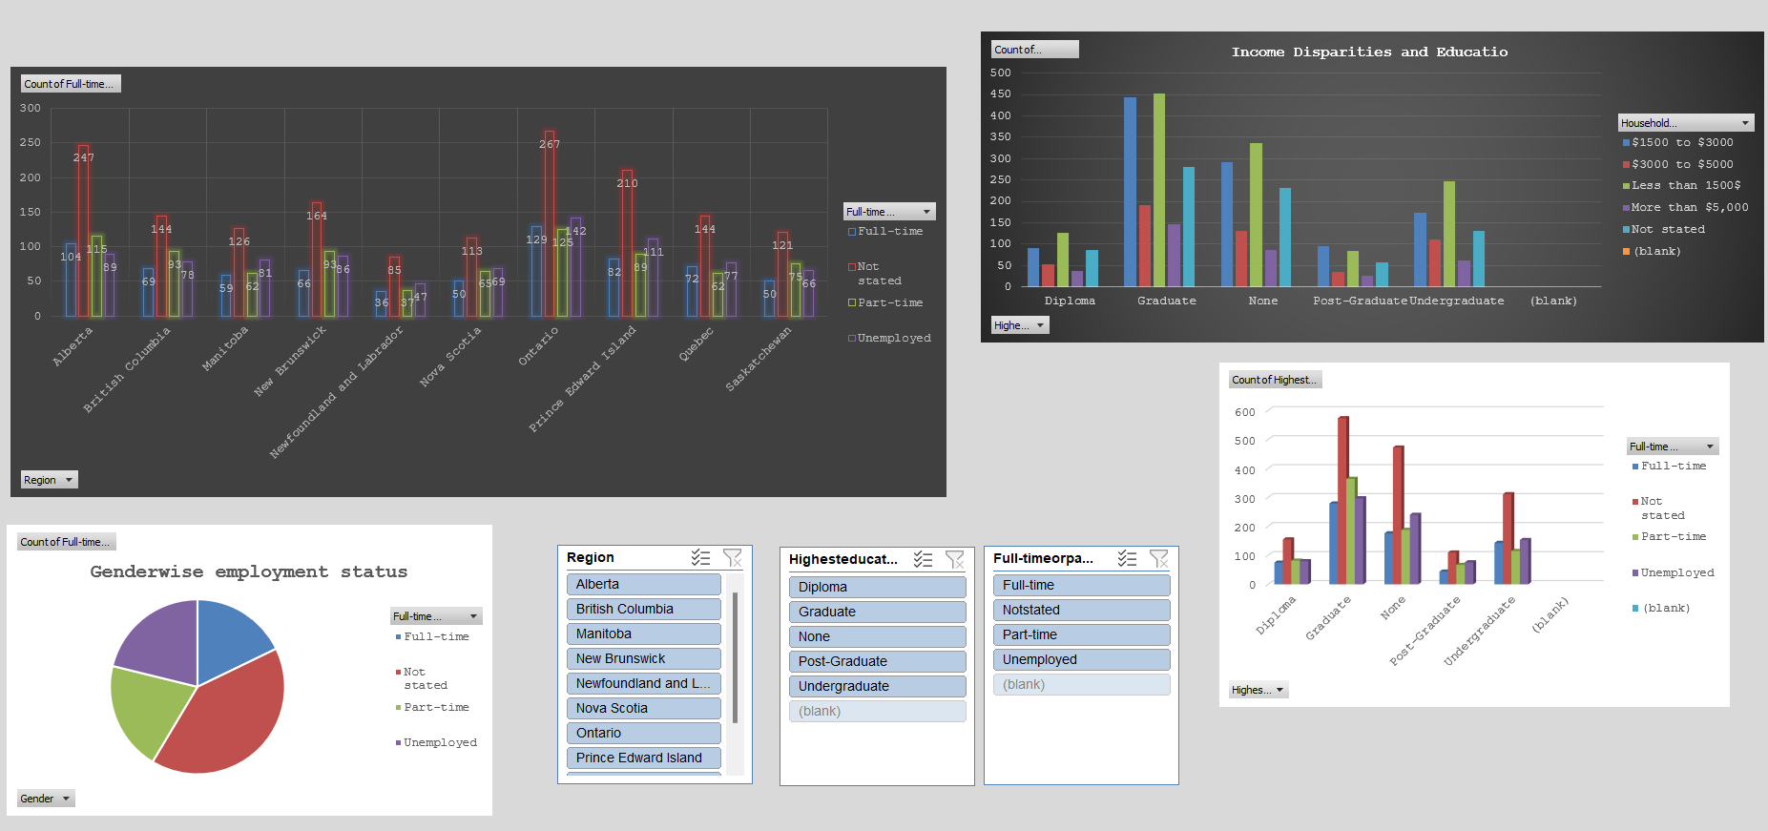
Dashboard

Slide 9
THANK YOU

